Slide 1


MORTALITÉ Covid-19
MONDE
Source: CSSE
21.9.20

Slide 2
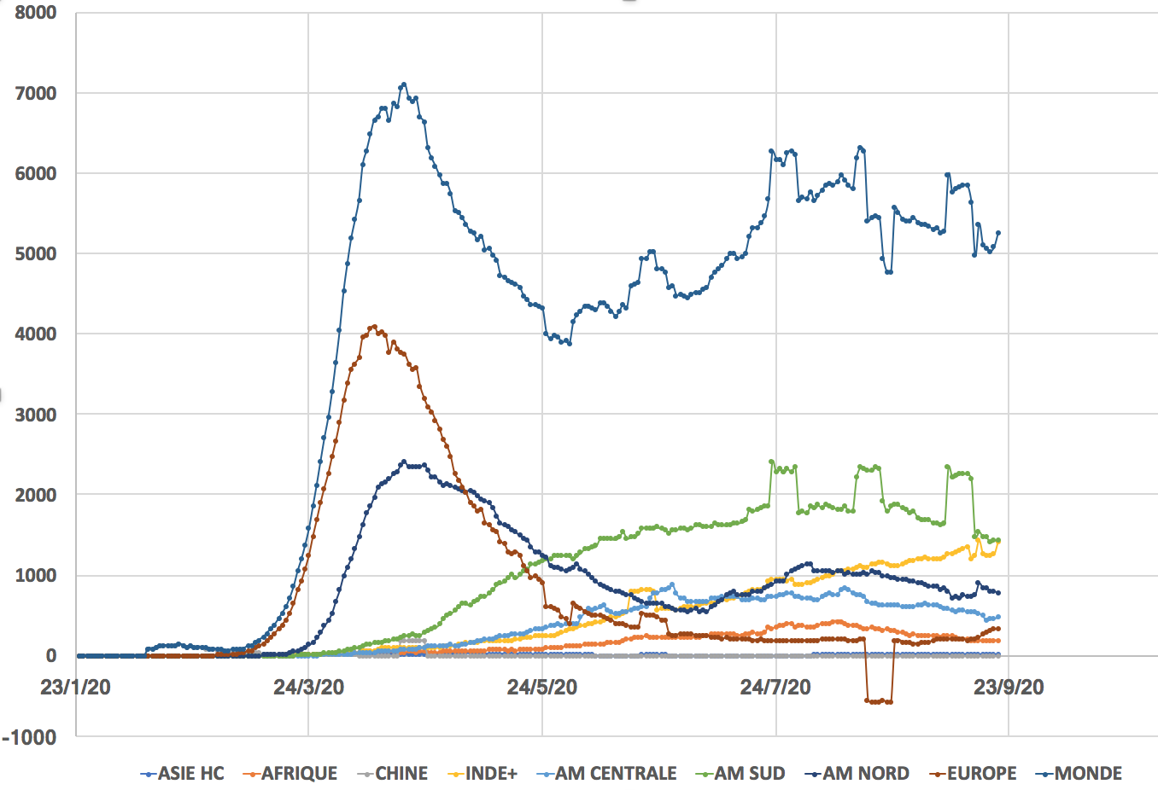
MORTALITÉ Covid-19
Evolution
des moyennes continentales (sur 7j glissants)
Source: CSSE
(HC: Hors Chine)
Source: CSSE
21.9.20

Slide 3
LÉTALITÉ Covid-19
MONDE
Source: CSSE
21.9.20
Létalité = nb total de Décès / nb total de Cas Positifs

Slide 4
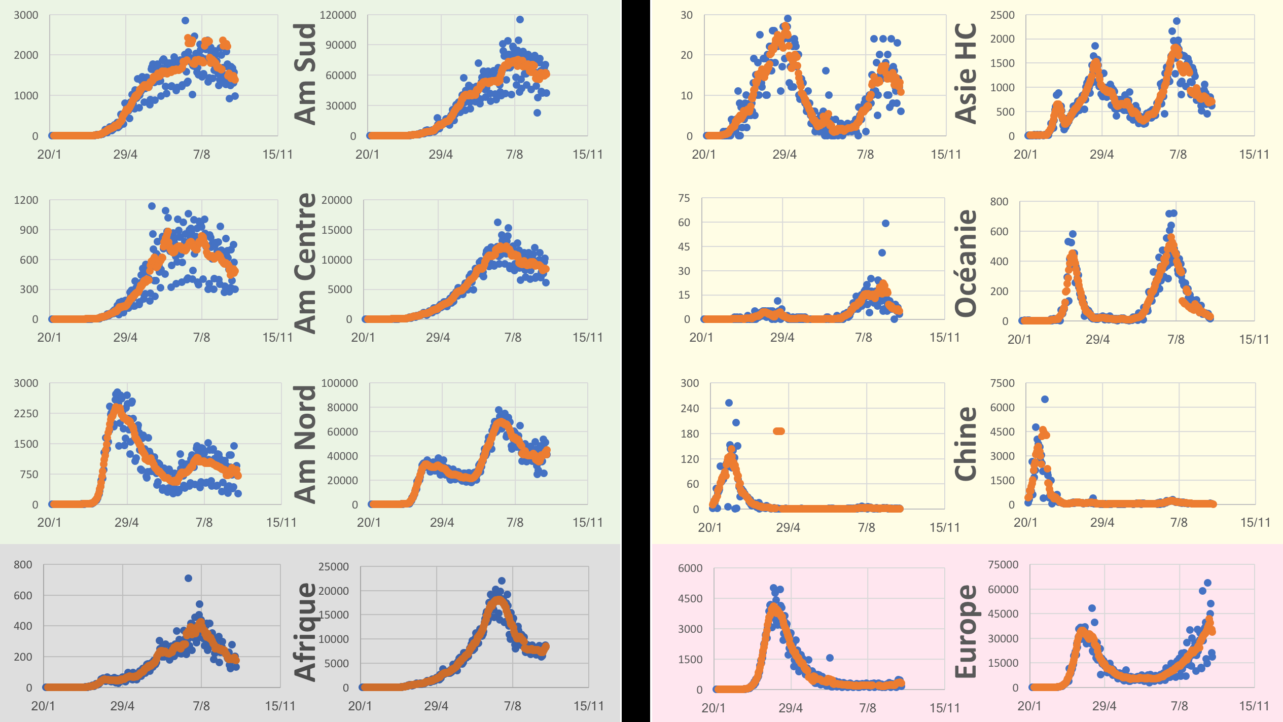
Décès
Tests+
Décès
Tests+
+32%
-97%

Slide 5
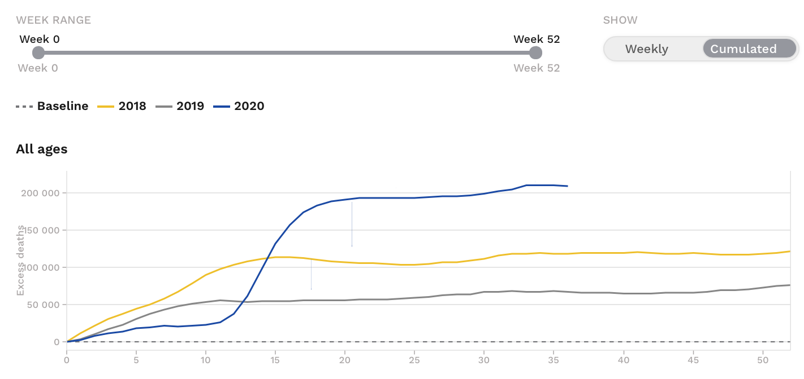
Covid-19
Europe
European mortality monitoring
EuroMomo
~115 000 décès en excès
90 000 par rapport à 2018
140 000 par rapport à 2019
dont ~15 000
en France
Semaines
Baisse "modeste" de l'espérance de vie
Guillot M, Khlat M, The Conversation 26/6/20
https://theconversation.com/epidemie-de-covid-19-quel-impact-sur-lesperance-de-vie-en-france-141484
https://www.euromomo.eu/graphs-and-maps/

Slide 6
European mortality monitoring
Covid-19
Europe
Z-score
Z-scores are used to standardize series and enable comparison of mortality pattern between different populations or different periods
The standard deviation is the unit of measurement of the z-score
It allows comparison of observations from different normal distributions
In general
Z-score = (mean of the population)/Standard deviation of the population
this could be approximated by
S-score = (number of deaths - baseline) / Standard deviation of the residuals
(variation of the number of deaths around the baseline)
on the part of the series used to fit the model, used as the standard unit
Z-score are computed on the de-trended and de-seasonalized series, after a 2/3 powers transformation according to the method by Farrington et al. 1996
This enables the computation of Z-scores for series that are originally Poisson distributed
https://www.euromomo.eu/how-it-works/what-is-a-z-score/

Slide 7
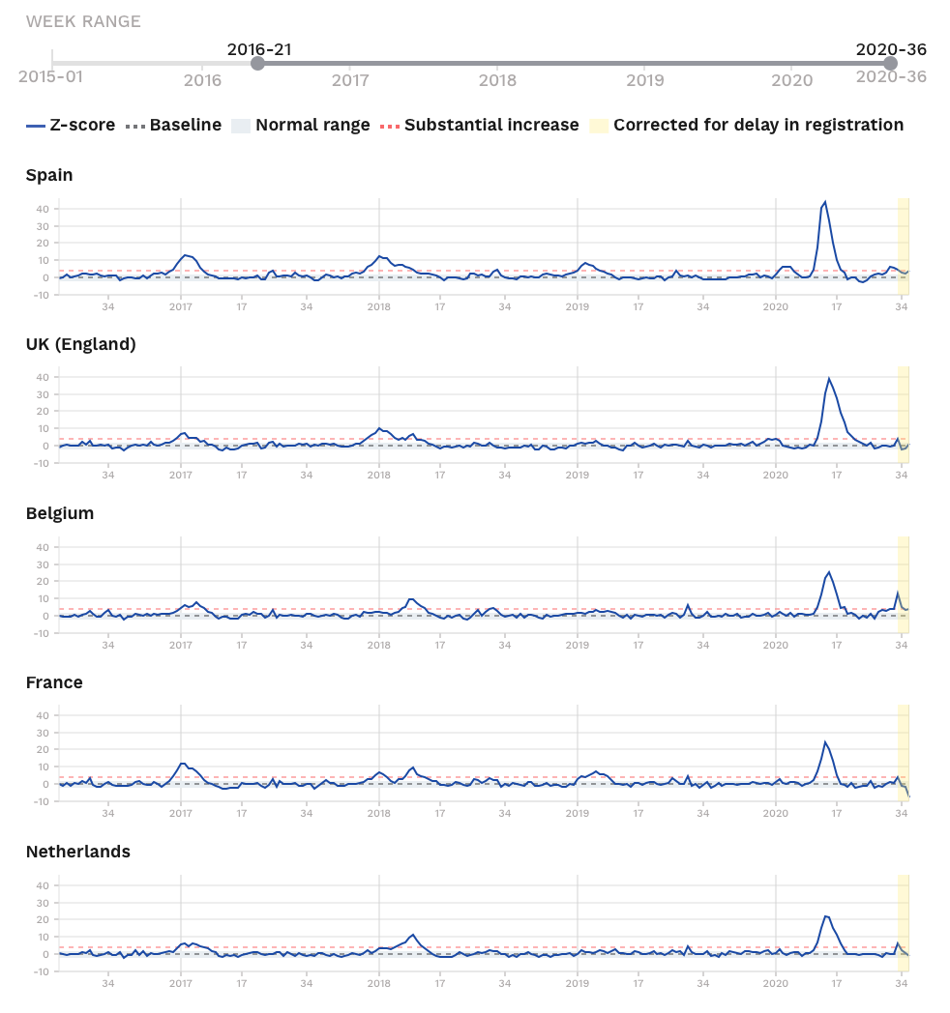
European mortality monitoring
Covid-19
Europe
Z-score
44
6
39
4
25
13
24
-7
22
6
https://www.euromomo.eu/graphs-and-maps/

Slide 8
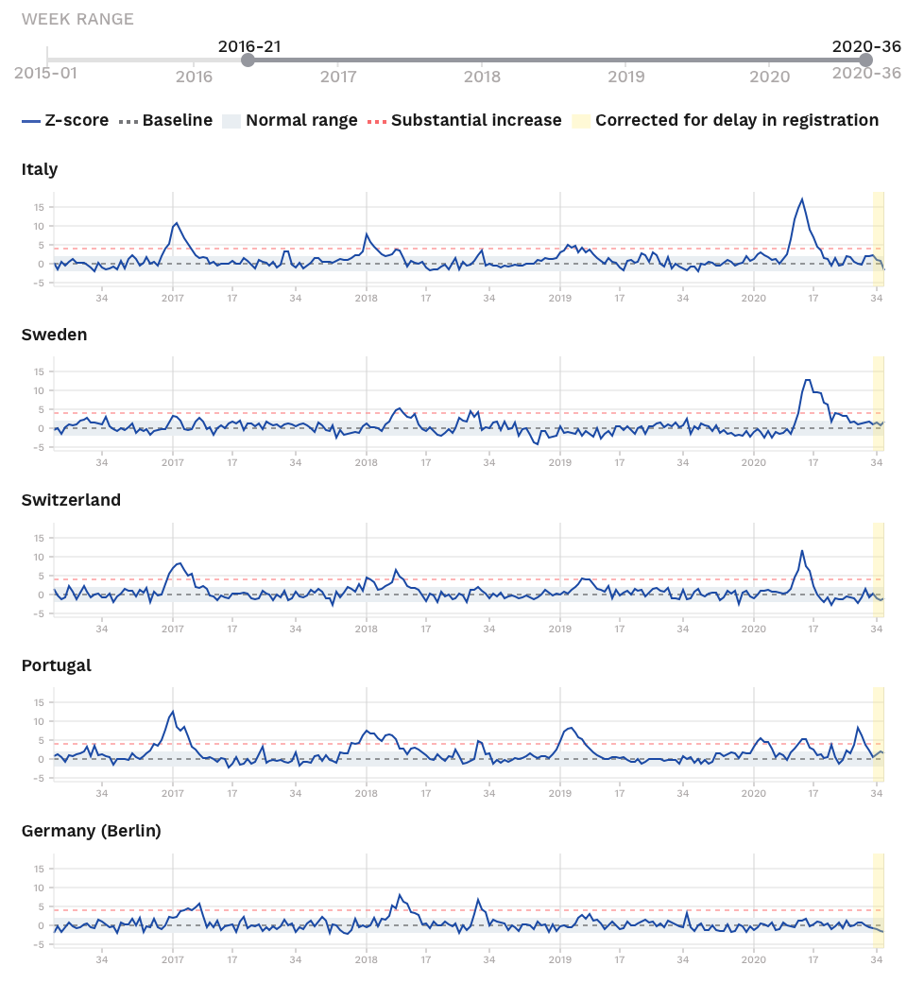
European mortality monitoring
Covid-19
Europe
17
13
12
8
0
https://www.euromomo.eu/graphs-and-maps/

Slide 9
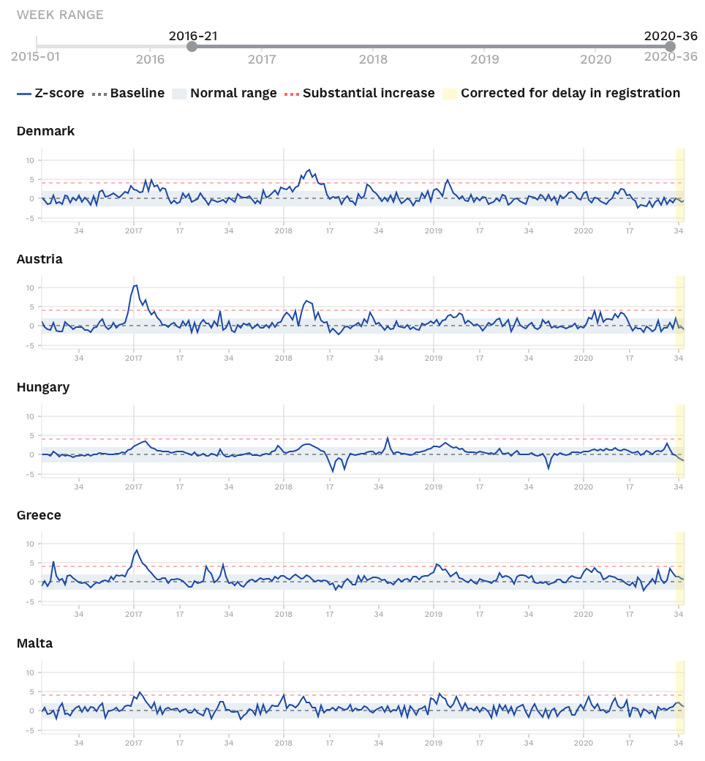
European mortality monitoring
Covid-19
Europe
https://www.euromomo.eu/graphs-and-maps/

